Slide 1


Texplained
Hardware Reverse-engineering Tools new threats – new opportunities

Slide 2

Texplained
Bio
8 years in a security lab
Technology lover
Analysis techniques // exploits
Involved from sample preparation to report writing
Optical systems setup
Sample preparation
Delayering
Imagery
Software developments

Slide 3
Texplained
Bio
Semi-invasive attacks
Invasive attacks – circuit edit
Micro-probing
Various experiments
Photoemission
AFM techniques
Electrical glitch

Slide 4
Texplained
Talk Description
Focus on Hardware reverse engineering
Evolution of the all process
Sample preparation
Imaging
Study
Change in evaluation criterias
Future evolutions
Talk description
context
Future developments
HRTs as the next step
HRT outcomes

Slide 5
Texplained
Context
Attacks summary
Chip classification
context
HRTs as the next step
HRT outcomes
Future developments

Slide 6
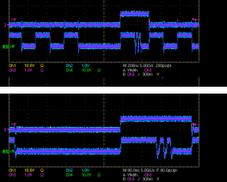
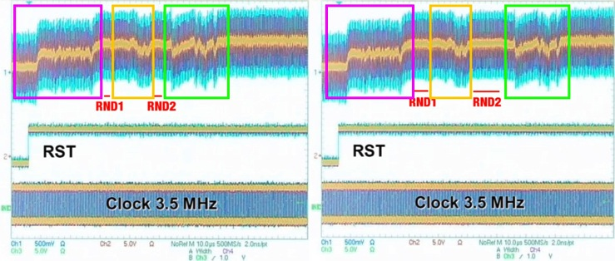
Texplained
Non invasive attacks - VCC and Clk glitch
Context – Attacks summary
Take advantage of the RTL technology
Used to skip instructions or to disturb the normal execution
Finding the glitch pattern is empirical
The real effect stays hidden

Slide 7
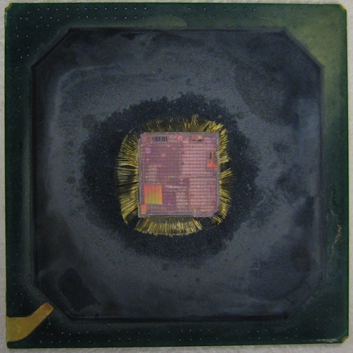
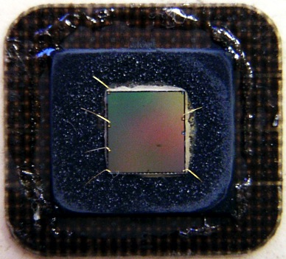
Texplained
Context – Attacks summary
Semi-invasive attacks - Sample preparation techniques
Partial opening - frontside

Slide 8
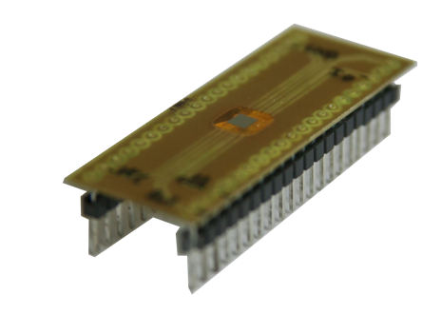
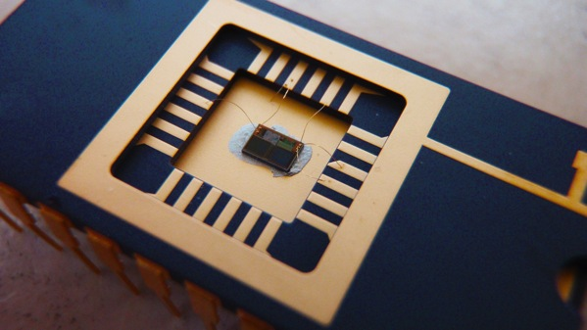
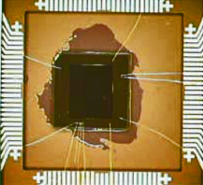
Texplained
Context – Attacks summary
Semi-invasive attacks - Sample preparation techniques
Repackaging

Slide 9
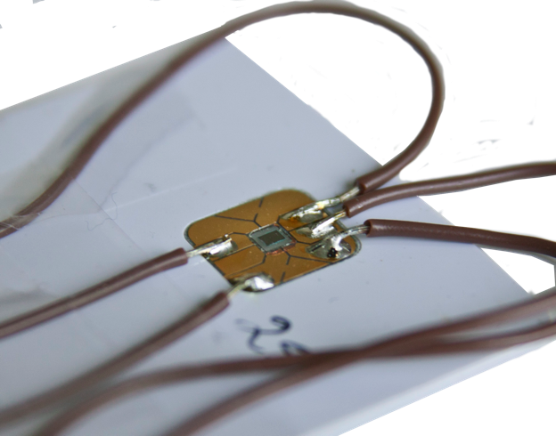
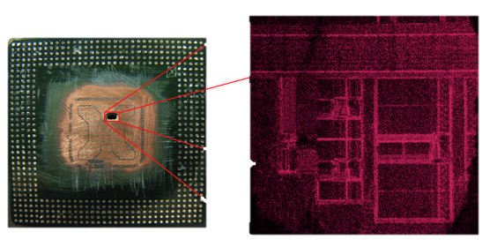
Texplained
Context – Attacks summary
Semi-invasive attacks - Sample preparation techniques
In situ:

Slide 10
Texplained
Context – Attacks summary
Semi-invasive attacks – Principle
1064 nm laser spot can induce transistor switch
Silicon is « transparent » @1064 nm
Metal planes prevent laser fault injection
Fault is injected at a precise given location

Slide 11
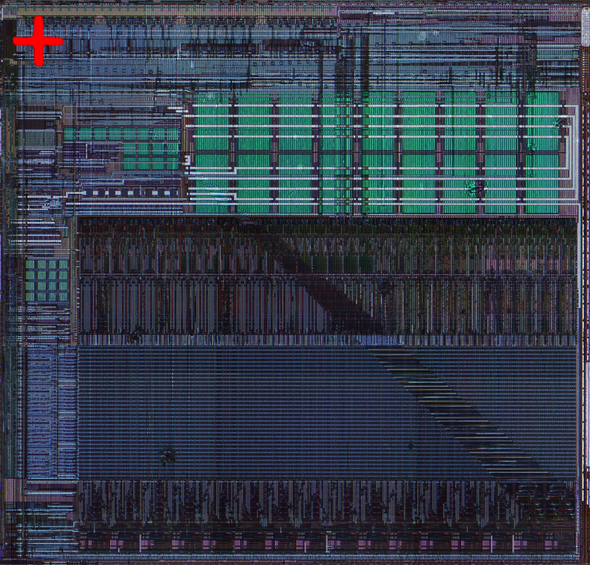
Texplained
Semi-invasive attacks – Tests
Fishing :
Context – Attacks summary
. Unknown timing
. Vague localization
. Trial and Error
=> Working ;-)

Slide 12
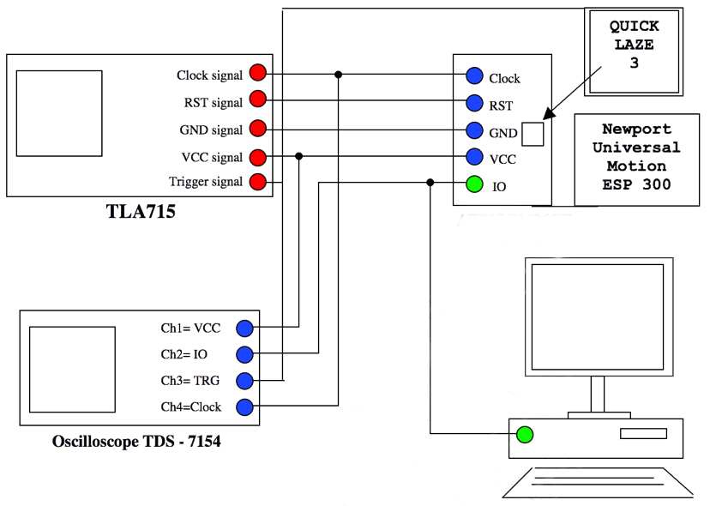
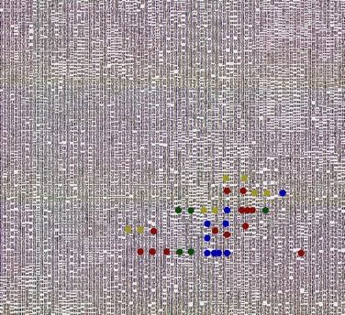
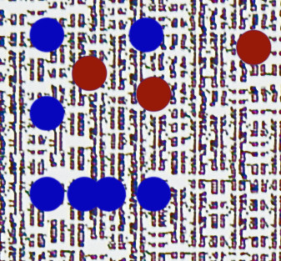
Texplained
Semi-invasive attacks – Tests
Automated fishing (a first step toward laser scan) :
Context – Attacks summary
. XY stages for chip positioning
. One position – several laser pulses
. Pass-fail from data returned by the device
. One scan per timing of interest
=> Different effects

Slide 13
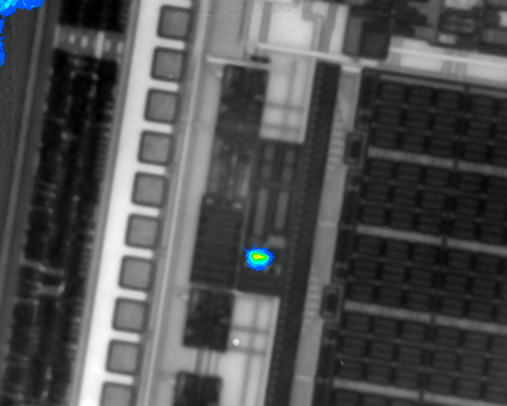
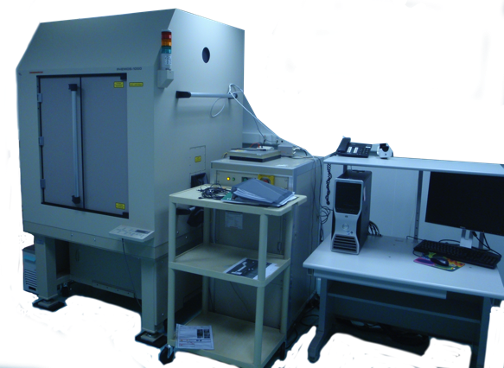
Texplained
Semi-invasive attacks – Tests
Targeted shot :
Context – Attacks summary
. Precise localization from laser scan image
. Timing still critical

Slide 14
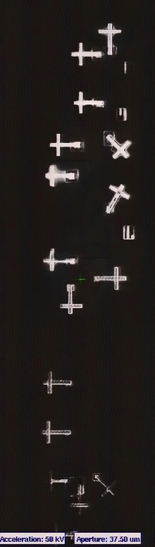
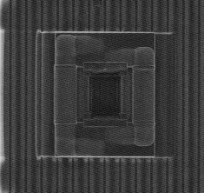
Texplained
Invasive attacks
Context – Attacks summary
Get access to the circuitry itself and apply modification for
Shield bypass
Embedded counter-measures deactivation
Data extraction

Slide 15
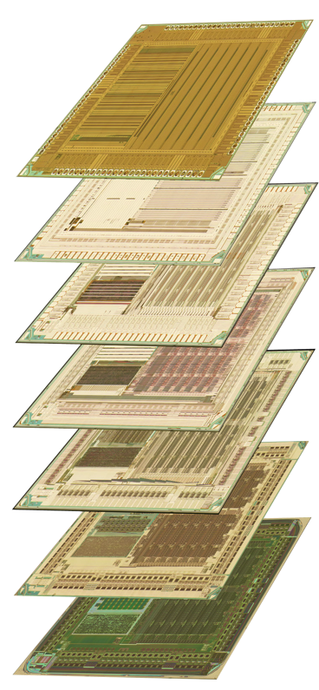
Texplained
Invasive attacks
The process : delayering and imaging
Context – Attacks summary
Delayering requires skills and machinery
Optical and / or SEM scan
Pictures stitching is key
Alignment of layers must be precise

Slide 16
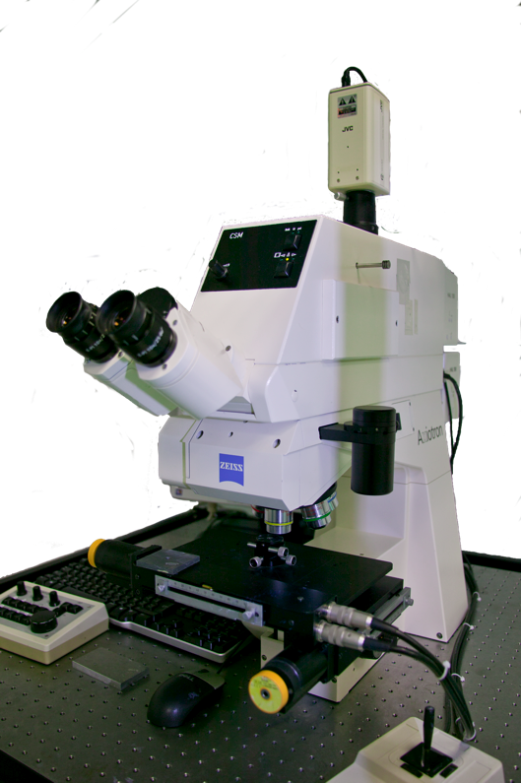
Texplained
Invasive attacks
The process : optical imaging
Context – Imaging techniques
Optical scans are fast to perform but :
Good tilt setup for high resolution scan is a nightmare (narrow depth of field)
Small features become invisible with technology size reduction
Oxide layers are light transparent (every deeper layer is visible)
Pictures lack information such as vias

Slide 17
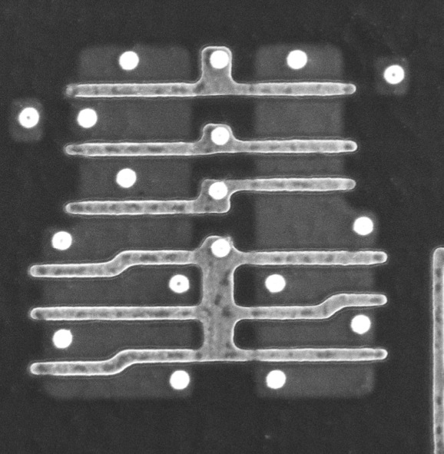
Texplained
Invasive attacks
The process : SEM imaging
Context – Imaging techniques
SEM scan are slow (hours range) and pictures are distorted but :
Depth of field is bigger
Resolution is higher
Oxide layers are not transparent (one visible layer at a time)

Slide 18
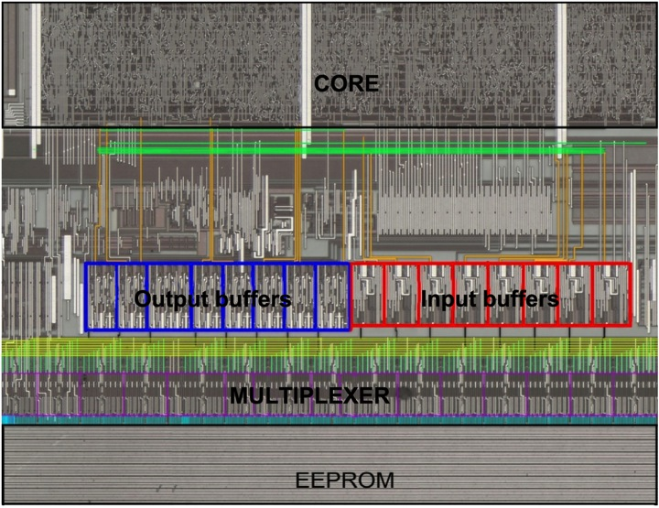
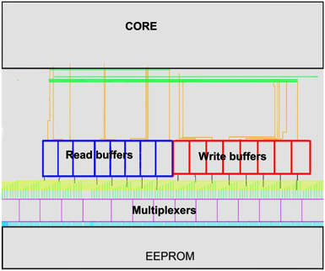
Texplained
Invasive attacks
The process : “Reverse-engineering”
Context – Attacks summary
Intensive use of pictures
Generate a test procedure
Localize points of interests

Slide 19
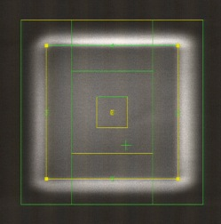
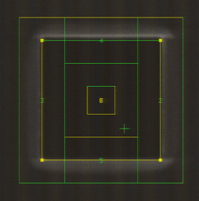
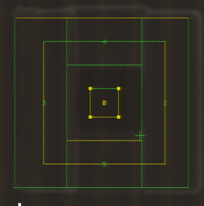
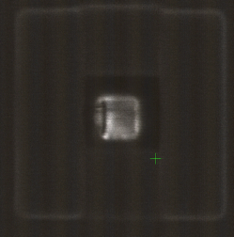
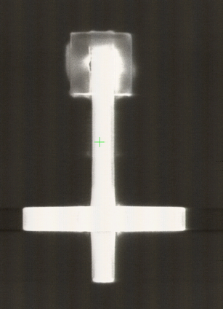
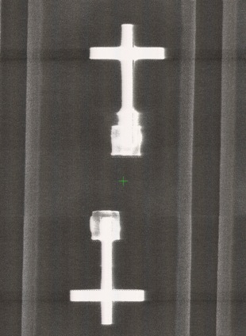
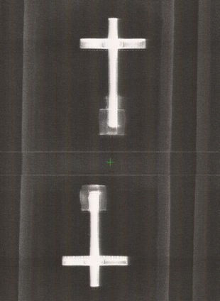
Texplained
Invasive attacks
The process : Fib edit
Context – Attacks summary

Slide 20
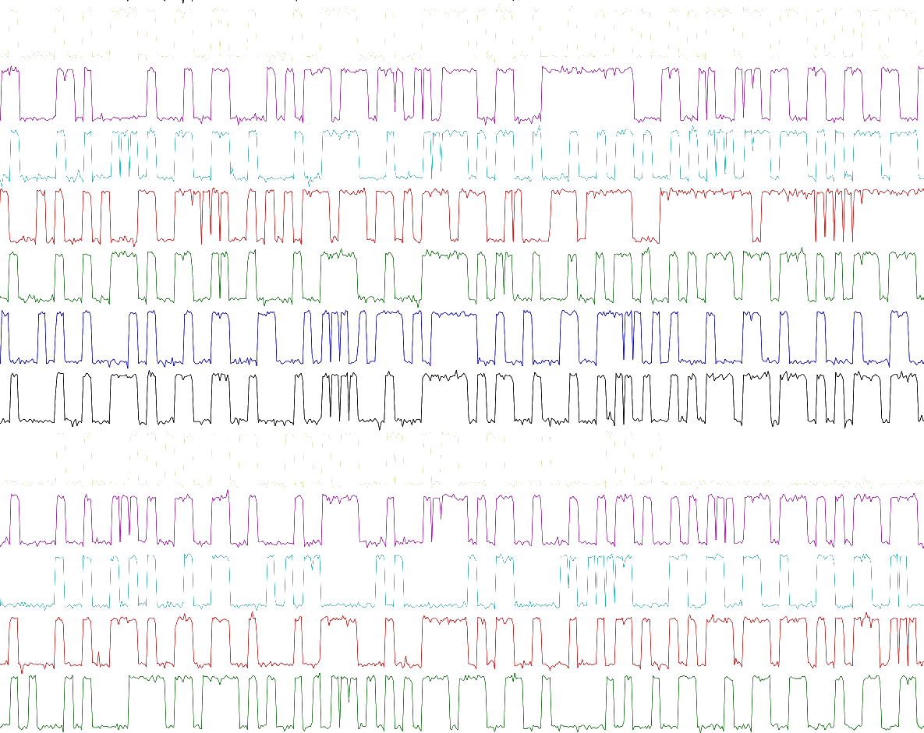
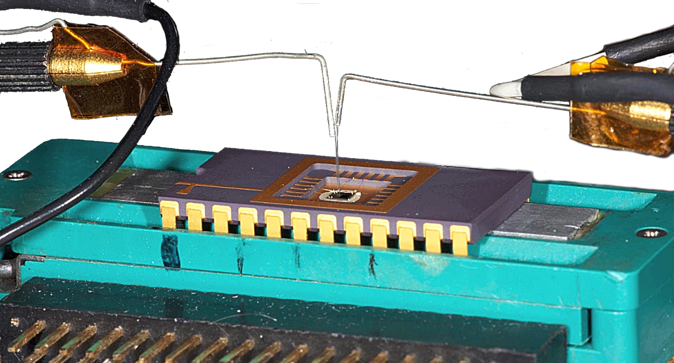
Texplained
Invasive attacks
The process : Micro-probing
Context – Attacks summary

Slide 21
Texplained
Invasive attacks
Linear Code Extraction
Context – Attacks summary
2 major types of instructions : sequential / jumps
Provide only one instruction to the core of sequential type
Core will execute something useless
Address will be incremented
The entire code will be outputted from NVM memory
=> Most successful invasive attack

Slide 22
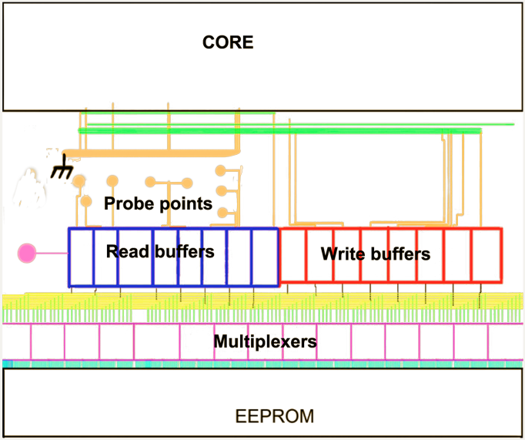
Texplained
Invasive attacks
Linear Code Extraction
Context – Attacks summary
Cut and setup an instruction for the core (ex. nop)
Read data before the cut

Slide 23
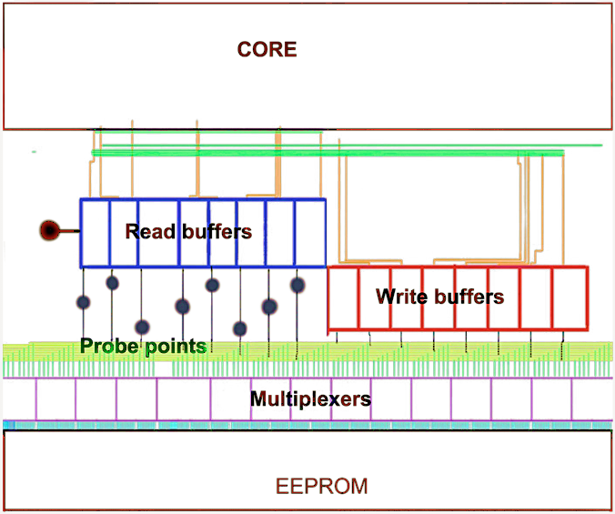
Texplained
Invasive attacks
Linear Code Extraction : Less FIBing – more options
Context – Attacks summary
Use buffer or register / latch signal to prevent read buffer output update
Read data before the buffer (register / latch)
Running code extraction is straight forward
Modification of the code is possible
Skipping instruction is possible (jumps…)

Slide 24
Texplained
Context – Chip classification
3 different kind of security levels :
Weak : code can be extracted by old techniques or LCE
Adequate : old techniques do not work // LCE can be done at the costs of Hardware Reverse-engineering
Advanced : Hardware Reverse-engineering is mandatory for a code extraction + hardware functions have to be found and studied

Slide 25
Texplained
Context – Chip classification
3 different kind of security levels :
Chip manufacturer | Pirates | Customer
Weak | Trivial | Dangerous cheap | No way
Adequate | Tricky | Balanced | Dangerous cheap
Advanced | Headache provider | Overkill expensive | Mandatory expensive

Slide 26
Texplained
Hardware Reverse-engineering Tools the next step
HRTs as the next step
HRT outcomes
Future developments

Slide 27
Texplained
HRTs as the next step
Analysis techniques evolution :
Laser fault injection
ROM code extraction
LCE
Other techniques
Sample preparation and imaging evolution :
Sample preparation
SEM imaging
Accurate correlation
All chip features become visible and usable

Slide 28
Texplained
Analysis techniques evolution :
Laser fault injection
HRTs as the next step
Usual tests target registers or memory output
Where are the working registers?
Is the memory encrypted?
Results can be achieved but hardly exploited
Fishing tests are also effective
Needed equipment price can be quite low
Effect can not be predicted
Timing and spot localization have to be found
Results can be achieved but can’t be fully understood therefore exploits are difficult to build
Fishing is a real threat

Slide 29
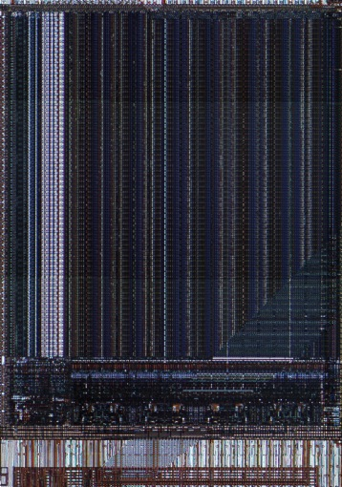
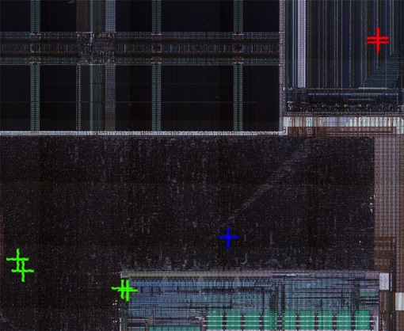
Texplained
Analysis techniques evolution :
Laser fault injection : examples
HRTs as the next step
Reading extra bytes from RAM while glitching during the ATR routine
Number of extra bytes depends on glitch location
Change mode of execution
Effect is “stored”
Original mode can be restored
Instruction skip
Registers can be found by fishing
Fault injected inside the core – what happened?

Slide 30
Texplained
Analysis techniques evolution :
LCE evolution
HRTs as the next step
Principle does not change
Memory encryption
Multiplexers mixed with the core

Slide 31
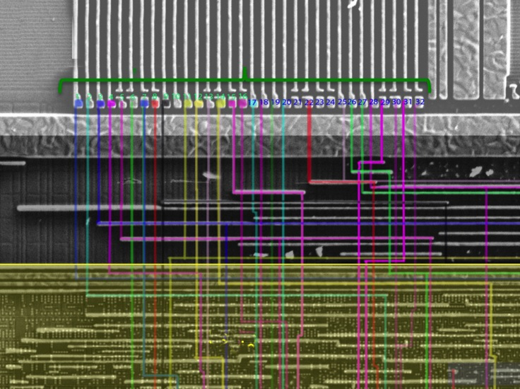
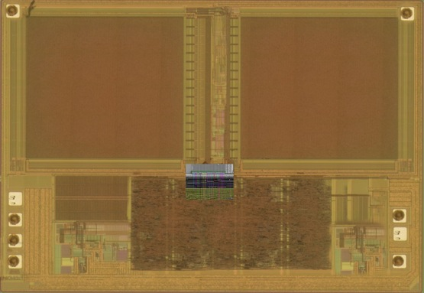
Texplained
Analysis techniques evolution :
LCE evolution : hidden mux
HRTs as the next step
8 bits processor
32 bits FLASH output going to the core

Slide 32
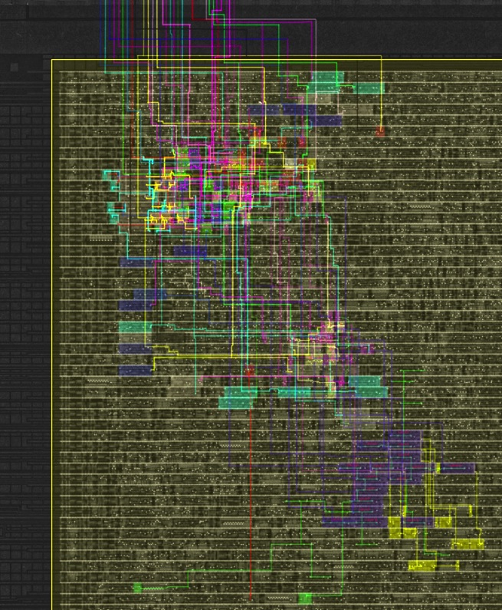
Texplained
Analysis techniques evolution :
LCE evolution : hidden mux
HRTs as the next step
Lines have to be traced inside the core to find the 8 bits data bus.

Slide 33
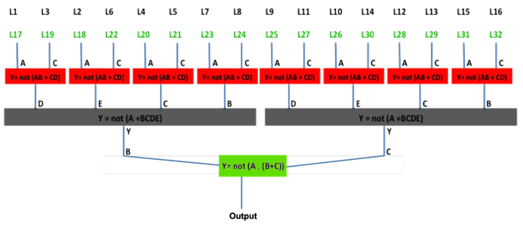
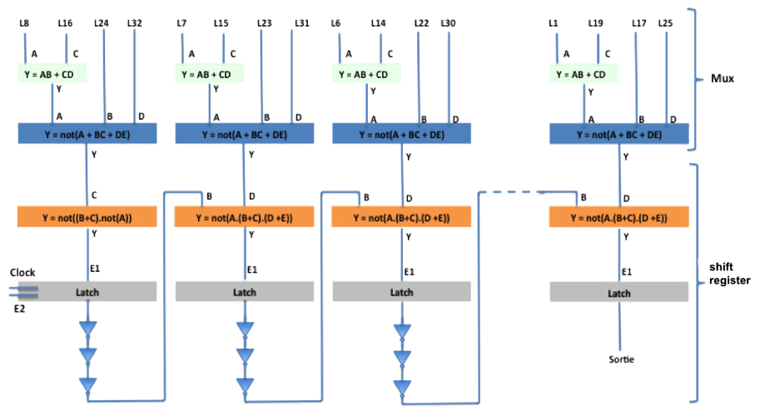
Texplained
Analysis techniques evolution :
LCE evolution : hidden mux
HRTs as the next step
3 paths can be followed :
2 of them can not be exploited

Slide 34
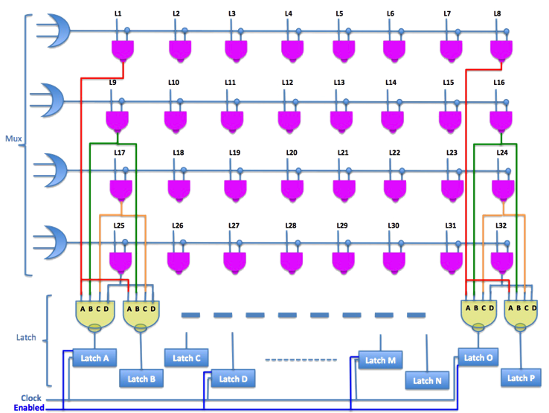
Texplained
Analysis techniques evolution :
LCE evolution : hidden mux
HRTs as the next step
Finding the correct spot took some time
Multiplexers were hidden
Data was not encrypted

Slide 35
Texplained
Analysis techniques evolution :
LCE evolution : state of the art
HRTs as the next step
Multiplexers are hidden
NVM content is scrambled
NVM content is encrypted
Hardware custom functions are implemented as part of the core
Several thousands gates have to be reversed

Slide 36
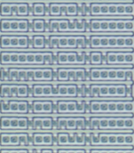
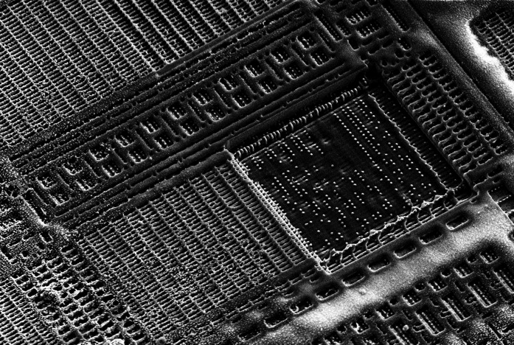
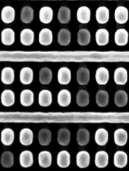
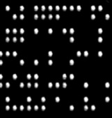
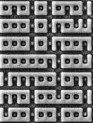
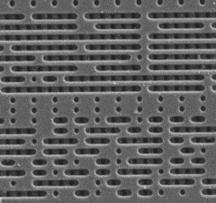
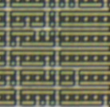

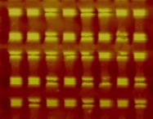
Texplained
Analysis techniques evolution :
ROM reading : ROM “optical reading”
HRTs as the next step

Slide 37
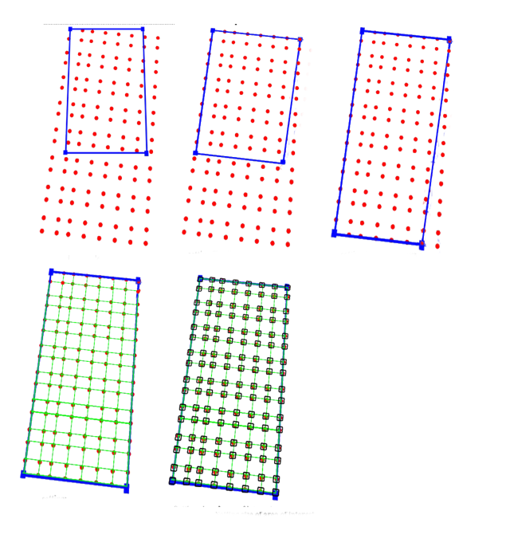

Texplained
Analysis techniques evolution :
ROM reading : principle
HRTs as the next step
Define 4 corners for alignment
Affine transformation to compensate “tilt deformation”
Define horizontal bit spacing
Define vertical bit spacing
Choose criteria for bit value
Extract defined zone
00100111
10101001
10001101
00011101
00001111
11100000
11111101
11111110
11010101
00011101
00001111
11100000
11111101
00011101
00001111
11100000

Slide 38


Texplained
Analysis techniques evolution :
ROM reading : correlation issue
HRTs as the next step
As ROMs are getting bigger, correlation errors have to be considered
4700 pictures have to be stitched

Slide 39

Texplained
Analysis techniques evolution :
ROM reading : correlation issue
HRTs as the next step
Smarter procedure :
Do not try correlating pictures (especially SEM pics) of a large scan
Do not try to tell your script where the bits are
Find bits corresponding to a noticeable value
Extract a grid from their position
From the grid, recover the missing bits
Correlate bits from an image with those of the adjacent one and so on

Slide 40


Texplained
Sample preparation and imaging evolution :
Deprocessing :
HRTs as the next step
By using plasma etching as the only technique for deprocessing, picture quality is poor

Slide 41



Texplained
Sample preparation and imaging evolution :
Deprocessing :
HRTs as the next step
Using combination of techniques such as Plasma etching, Chemical Mechanical Polishing and wet chemical etching leads to “perfect” deprocessing, suitable for SEM scan.

Slide 42

Texplained
Sample preparation and imaging evolution :
Deprocessing :
HRTs as the next step
One layer visible at a time
Vias also visible
Custom process to distinguish vias and lines has been defined

Slide 43
Texplained
Sample preparation and imaging evolution :
SEM imaging :
HRTs as the next step
Major issue was found and solved : SEM picture distortion
Tilt adjustment table has been machined
Fast scan
Distortion is calculated for a given scan and reversed

Slide 44

Texplained
Sample preparation and imaging evolution :
Features on grid :
HRTs as the next step

Slide 45

Texplained
Sample preparation and imaging evolution :
Find vias :
HRTs as the next step

Slide 46

Texplained
Sample preparation and imaging evolution :
Find lines :
HRTs as the next step

Slide 47


Texplained
Sample preparation and imaging evolution :
Accurate correlation
HRTs as the next step
Correlation is performed on feature coordinates “grid pattern”
At worst, lines are “jittering” around the calculated grid position

Slide 48

Texplained
Sample preparation and imaging evolution :
Accurate correlation
HRTs as the next step

Slide 49

Texplained
Sample preparation and imaging evolution :
2 layers example:
HRTs as the next step

Slide 50

Texplained
Sample preparation and imaging evolution :
All information available
HRTs as the next step
Vias and lines are extracted on a grid
Gates are detected from the same mechanics
No correlation error
Layers are aligned “perfectly” without further picture transformation
No more pixels – polygons only ☺

Slide 51
Texplained
Hardware Reverse-engineering Tools outcomes
Sample preparation and imaging evolution :
All information available
HRTs as the next step
HRT outcomes
Future developments

Slide 52
Texplained
New possibilities :
Some possible studies
HRTs’ outcomes
semi-invasive preparation
LCE preparation
Shield global bypass
Other embedded counter-measures bypass

Slide 53
Texplained
New possibilities :
Other techniques
HRTs as the next step
Photoemission
EMA
Dynamic voltage contrast

Slide 54

Texplained
New possibilities :
New tools
HRTs’ outcomes
FIB navigation files can be generated
Planarised chip
Backside edit

Slide 55

Texplained
New threats :
Laser fault injection :
HRTs’ outcomes
Particular gates can be highlighted without any further study
Fire at the located registers and see the effects
Tracing signals is easy as a click
Fire first, with for example a pass-fail scan
Look at what you hit at “fail” location
Understand the effect
=> From laser glitching to laser fault injection.

Slide 56



Texplained
New threats :
Laser fault injection become cheaper
Context – Attacks summary

Slide 57
Texplained
New threats :
Scan chains analysis :
HRTs’ outcomes
Path chain are very easy to spot
Used to debug / program the device

Slide 58
Texplained
Timing consideration :
Real world example :
HRTs’ outcomes
ROM chip
ROM is scrambled
Multiplexers are hidden inside the logic
ROM is encrypted
Data encryption based on address and hard-wired key
-> Clear data bus location ?
-> Custom encryption reverse ?

Slide 59

Texplained
Timing consideration :
Image preparation : “manual process”
HRTs’ outcomes
Correlation is based on pixel value :
From 10 minutes to several hours
Errors are inevitable
Image stitching is not reliable
One picture = one photoshop layer
Local adjustments are performed when needed
Alignment of 2 layers almost unfeasible but fast
Local adjustments are performed when needed

Slide 60



Texplained
Timing consideration :
Finding data bus : “manual process”
HRTs’ outcomes
Tons of layers are used and moved for local adjustment : Errors
A schematic must be drawn to avoid being lost : Errors + you will get lost anyway

Slide 61
Texplained
Timing consideration :
Finding data bus : “manual process”
HRTs’ outcomes
Each found gate must be analyzed even if already studied : Errors + stay patient
Equations have to be written in “mathematical form” : Many errors
cell_3_12 = (cell_9_24 xor cell_9_18) xor cell_1_18
cell_3_13 = (cell_9_20 xor cell_9_19) xor cell_1_23
cell_3_13bis = (cell_3_14 xor cell_9_25) xor cell_5_2
cell_3_14 = (cell_8_4 xor cell_g_1) xor cell_6_7
cell_3_15 = (cell_alpha_1 xor cell_9_40) xor cell_13_6
cell_3_16 = (cell_a_1 xor cell_1_19) xor cell_13_3
cell_3_17 = (cell_9_21 xor cell_9_22) xor cell_1_24

Slide 62
Texplained
Timing consideration :
Finding data bus : “manual process”
HRTs’ outcomes
-> Finally, with help of vhdl software (for example), schematic can be re-arranged to understand the functions.
Localization of the clear data bus is possible
LCE is working
-> My FIB is down but I have reverse-engineered every single gate, I can read the ROM…
VHDL simulations will show…. that there are errors ☹
Localizing the errors can partially be made from simulations
Where are the last errors?

Slide 63

Texplained
Timing consideration :
Deprocessing
HRTs’ outcomes
Deprocessing for hardware reverse-engineering takes extra steps
This process is not suited for optical imaging
Complete deprocess can be achieved in about a week

Slide 64
Texplained
Timing consideration :
Image preparation : with HRT
HRTs’ outcomes
Select area of interest and selection of rejected features(10 minutes per layer)
Find vias (> 100 images per minutes)
Find grid and lines (< 1 hour per layer)
Extract gates (1 hour)
Correct one layer : (1 day)
Correlate and transform pictures + generates layer netlist (< 1 hour)
Align 2 layers together (2 minutes)

Slide 65


Texplained
Timing consideration :
Reverse-engineering custom logic : with HRT
HRTs’ outcomes
One layer per layer
No stitching problem
No local layer adjustment
One click to follow net(s)
Equations are generated automatically as well as schematic
No re-writing errors, software is highlighting what is missing

Slide 66
Texplained
Timing consideration :
Timing :
HRTs’ outcomes
After 2-3 weeks, every features are detected with good HRT
2 weeks later (average), LCE can be started
Same work with « manual process » would take months

Slide 67


Texplained
Timing consideration :
Timing difference : reversing custom logic
HRTs’ outcomes
6 months after start of the study, results are still not exploitable
With first generation of HRT, same study was performed in 2 months
With next generation of the tool, time will be reduced to 1 month
* With classical method, you would not have found the correct spots for LCE at this stage

Slide 68
Texplained
New threats : Possible “achievements” :
HRTs’ outcomes
100 % success rate for hackers (excluding customized chip)
6 to 12 microcontrollers a year (first extraction)
XX customized chip a year
The advanced security level becomes at best adequate
Custom hardware functions become a new kind of ROM that could be extracted from pictures only
Piracy
Counterfeiting
Patent violation

Slide 69
Texplained
New opportunities :
HRTs’ outcomes
Better security level : in depth security evaluation with new techniques
Design and routing new strategies to make invasive work more complicated
Anti-piracy by changing the nature of the hardware custom functions
Affordable patent violation studies
Counterfeiting characterization
ICs’ obsolescence

Slide 70
Texplained
Future developments
New opportunities :
HRTs’ outcomes

Slide 71
Texplained
Future developments
Schematic creation and interaction
From gates to functions : automatic gates grouping to reduce number of blocs to study
Fast detection of « non aligned » features : from core to chip
Simulator, specific analysis
…

Slide 72
Texplained
Hardware Reverse-engineering Tools new threats – new opportunities
Q&A…
Olivier Thomas
+33 664 800 687
olivier@texplained.com
Notes:
END
thank you for your attention
I would be very happy to answer to your questions.
thanks.

